Slide 1
OSLC Resource Shape: A Linked Data Constraint Language
Arthur Ryman & Achille Fokoue, IBM
W3C RDF Validation Workshop, Cambridge, 2013-09-11

Slide 2
Topics
About OSLC
Resource Shape
Use cases
Vocabulary
SPARQL semantics

Slide 3
Open Services for Lifecycle Collaboration
“An open community building practical specifications for integrating software”
Change Management, Quality Management, Requirements Management, …
REST APIs based on Linked Data principles
Ongoing development transitioning to:
W3C (Linked Data Platform)
OASIS

Slide 4
Resource Shape
Is a high-level, declarative, programmer-friendly description of the expected contents of an RDF graph
RDF terms that appear in a graph typically come from many vocabularies
Defines constraints on RDF graphs
unlike RDFS or OWL which define inference rules
Does not claim to be a complete RDF constraint language
Covers commonly occurring cases

Slide 5
Use cases
REST APIs
Machine-readable constraints on the RDF contained in HTTP request and response bodies
Suitable for programmatic validation
Metadata for tools
Query builders
Form builders
Documentation for humans
Specifications
Online help

Slide 6
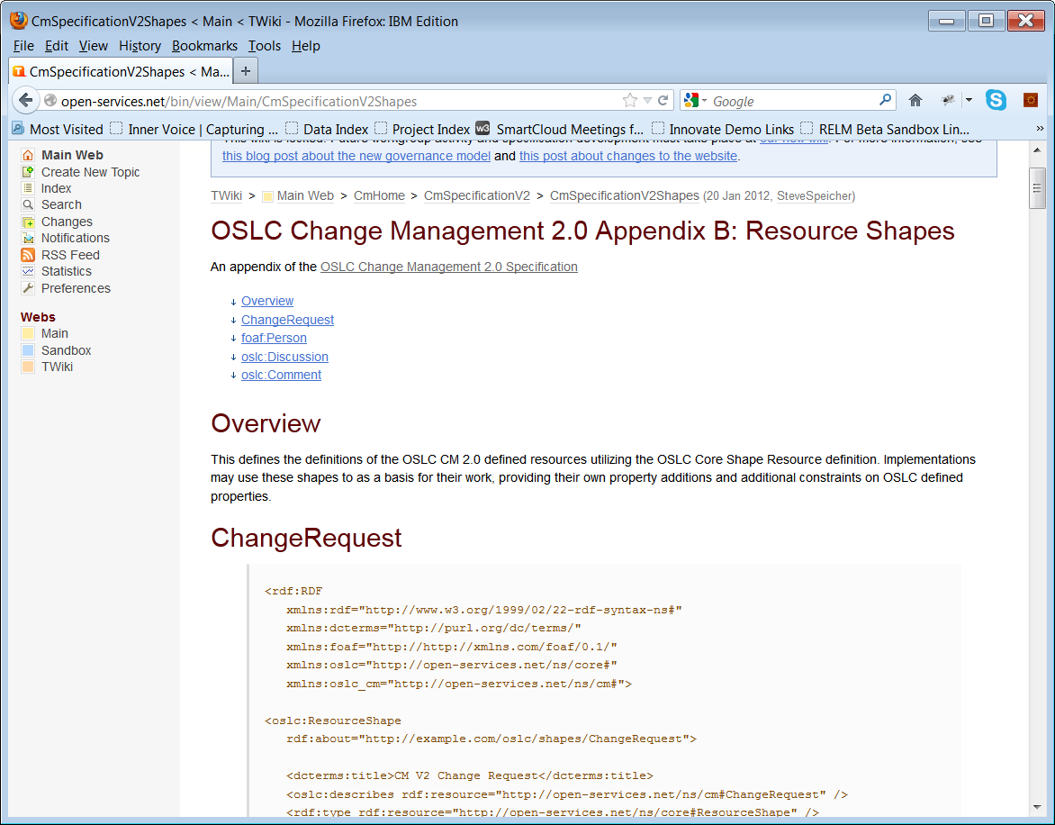
Specification example

Slide 7
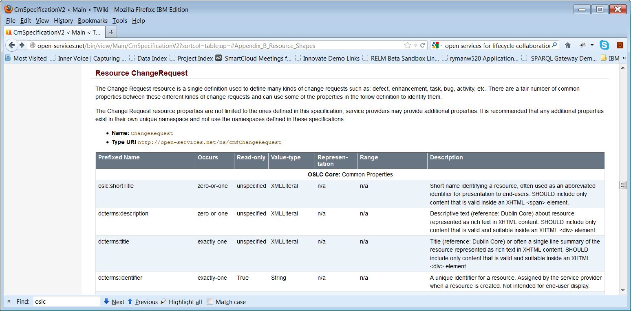
Documentation example

Slide 8
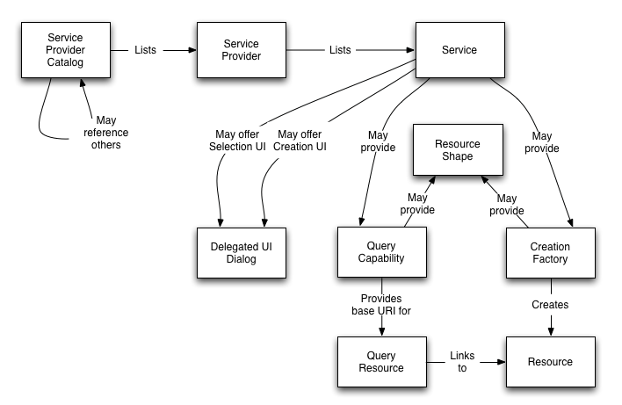
Vocabulary
Defined by OSLC Core V2.0

Slide 9
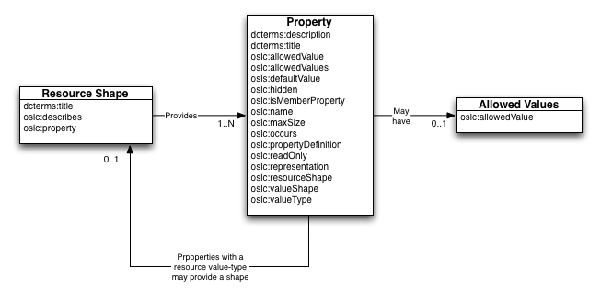
Vocabulary
RDF terms are defined in Appendix A

Slide 10
Example
@prefix dcterms: <http://purl.org/dc/terms/> .
@prefix oslc: <http://open-services.net/ns/core#> .
@prefix oslc_cm: <http://open-services.net/ns/cm#> .
@base <http://example.com/shape/oslc-change-request> .
<> a oslc:ResourceShape ;
dcterms:title "Creation shape of OSLC Change Request" ;
oslc:describes oslc_cm:ChangeRequest ;
oslc:property <#dcterms-title>, <#oslc_cm-status> .
<#dcterms-title> a oslc:Property ;
oslc:propertyDefinition dcterms:title ;
oslc:occurs oslc:Exactly-one .
<#oslc_cm-status> a oslc:Property ;
oslc:propertyDefinition oslc_cm:status ;
oslc:occurs oslc:Zero-or-one .

Slide 11
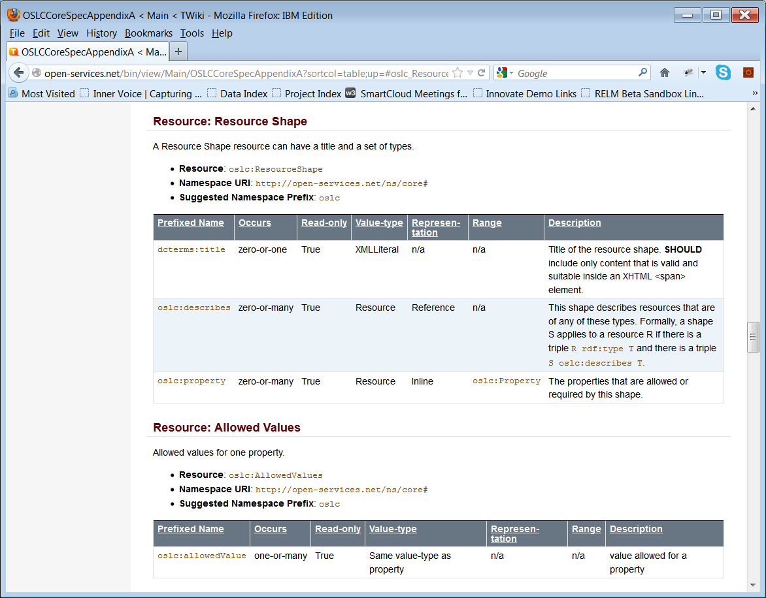

Slide 12
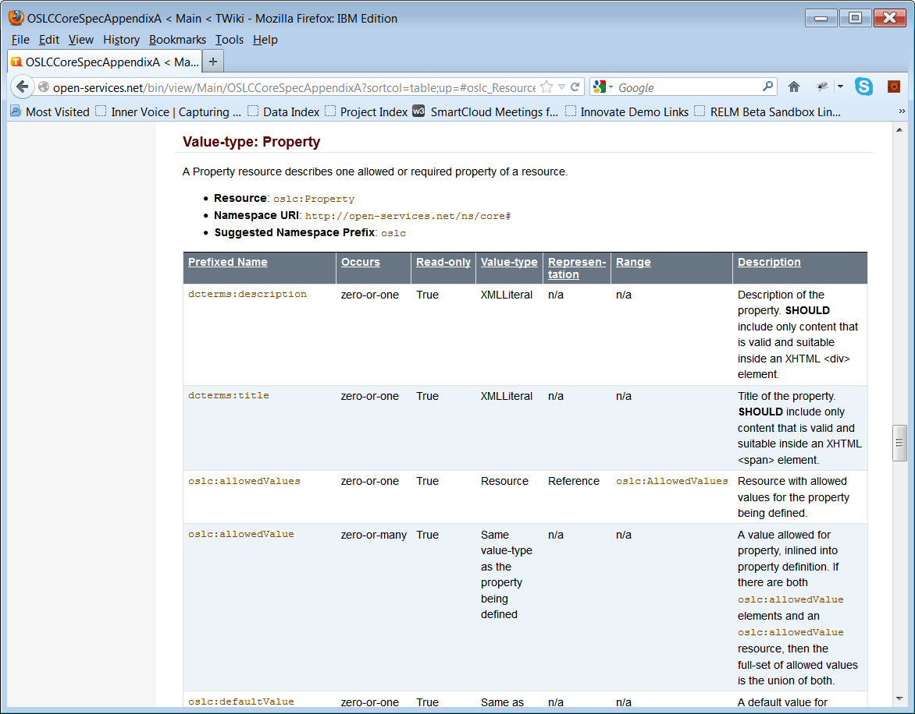

Slide 13
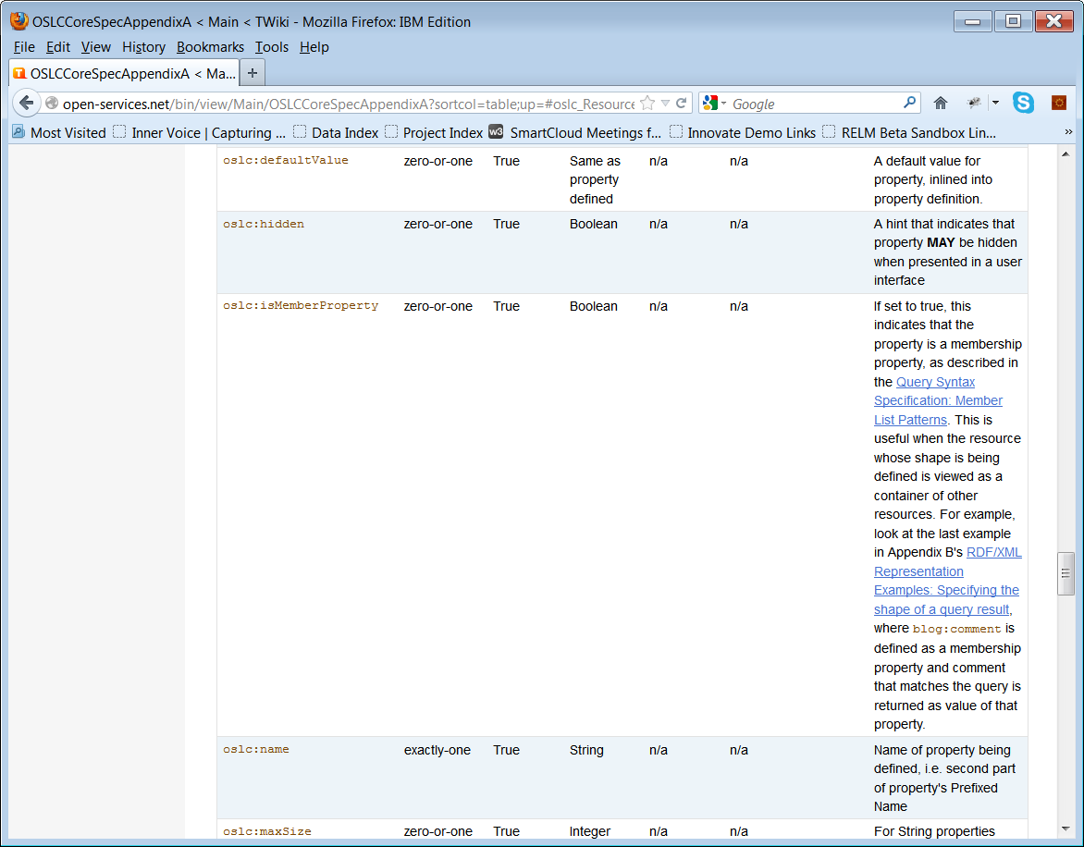

Slide 14
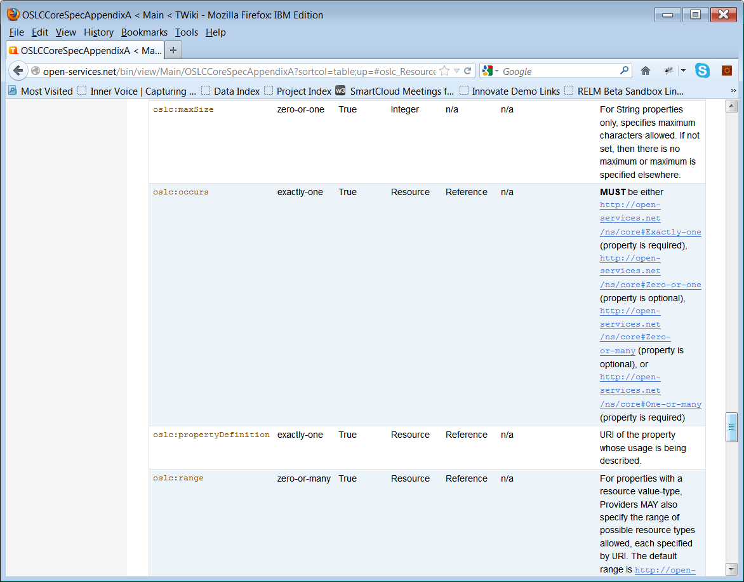

Slide 15
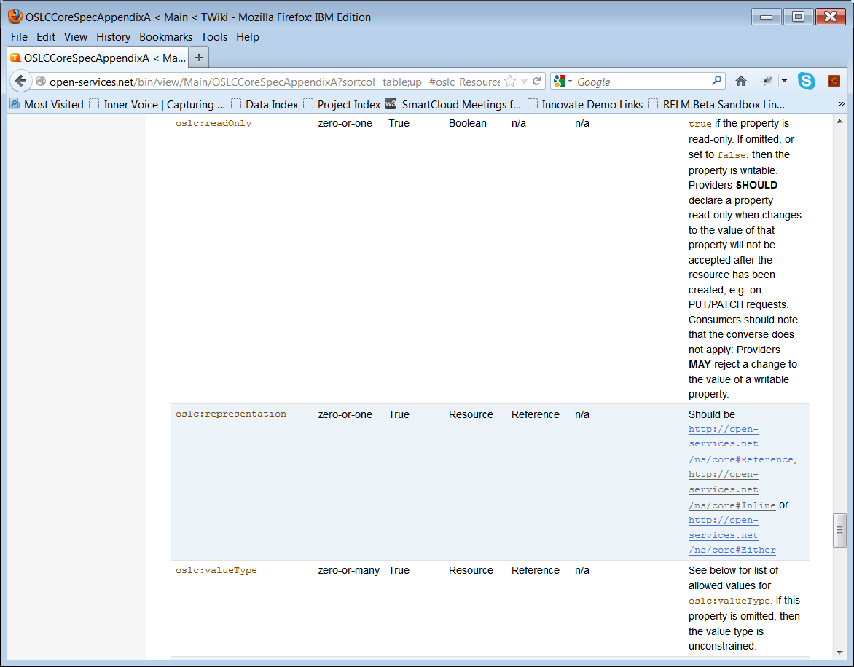

Slide 16
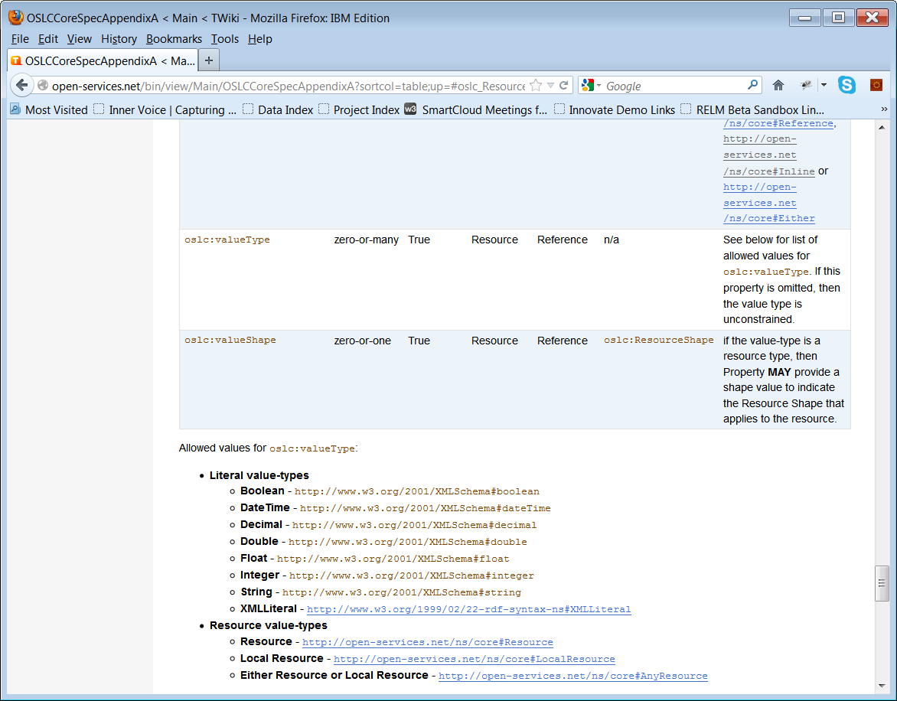

Slide 17
SPARQL semantics
It is natural to define the semantics of Resource Shape constraints using SPARQL ASK
Assertions should return TRUE
Exceptions should return FALSE
If a constraint is violated, it is also useful to have a SPARQL query that returns the reason
Some constraints implicitly refer to other graphs
Operation post-conditions refer to the “after” graph
Range constraints may refer to remote resources, e.g. asserting their type

Slide 18
SPARQL assertion for: olsc:occurs oslc:Zero-or-one
prefix oslc_cm: <http://open-services.net/ns/cm#>
ASK
{
{
select ?resource
where {
?resource a oslc_cm:ChangeRequest.
?resource oslc_cm:status ?status
}
group by ?resource
having (count(?status) <= 1)
}
}

Slide 19
SPARQL exception for: olsc:occurs oslc:Exactly-one
prefix oslc_cm: <http://open-services.net/ns/cm#>
ASK
{
?resource a oslc_cm:ChangeRequest.
?resource oslc_cm:status ?status1.
?resource oslc_cm:status ?status2.
FILTER (?status1 != ?status2)
}

Slide 20
Summary
OSLC Resource Shape is a high-level RDF vocabulary for describing commonly occurring constraints on RDF graphs
NOT a full constraint language
Motivated by REST API documentation and tool metadata use cases (query, creation)
Expressible as SPARQL Ask queries
In production use at OSLC

